Slide 1
Bridging the Gaps Album
Photos submitted by Terry Walker and Nancy Dumais
Terrace, ECEBC Leadership Cohort 5, August 2014

Slide 2
Bridging the Gaps
Thinking about the next generation of Early Childhood Educators in our community, we plan to strengthen ties with other ECE communities in our region by coming together for inspirational and reflective practice retreats. Deeper, more cohesive and meaningful relationships among ECE’s create awareness of our work and enthusiasm for what we do (Community of Innovation, Project Report, 2013).

Slide 3
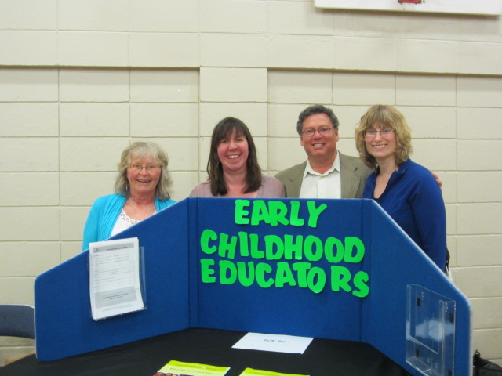
Nancy, Nicole and Terry visit with their MLA (Early Years Fair)

Slide 4
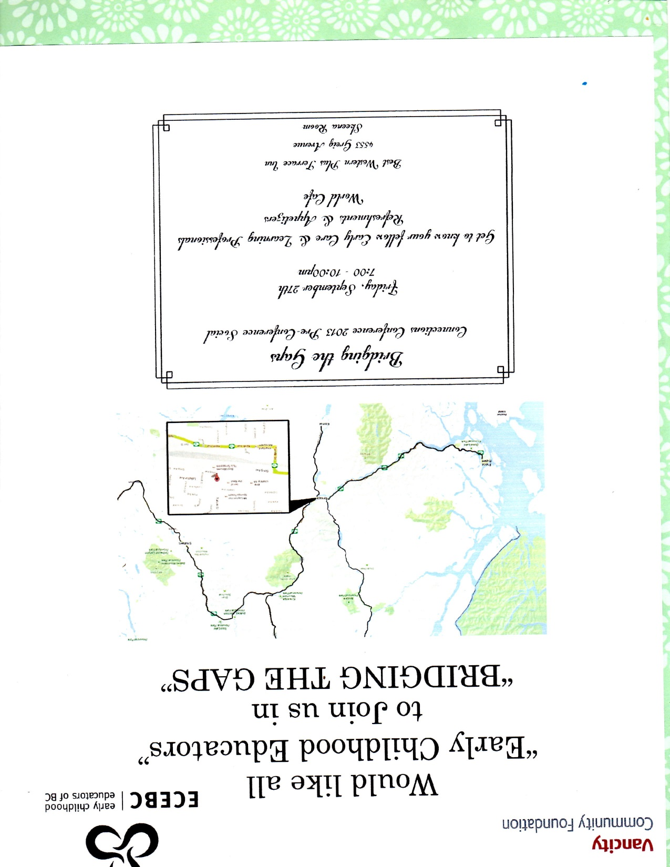

Slide 5
Raising the Village Workshop

Slide 6
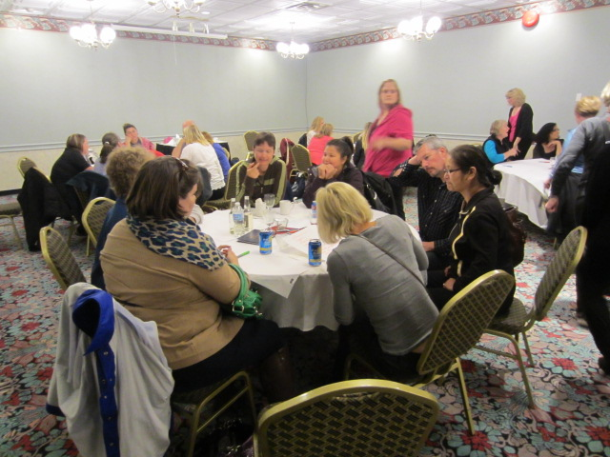
Raising the Village Workshop

Slide 7
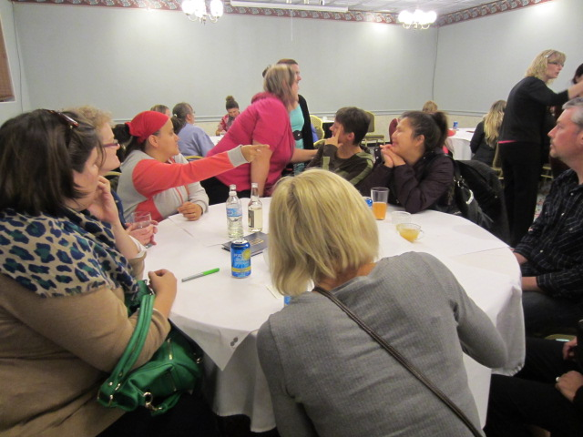

Slide 8
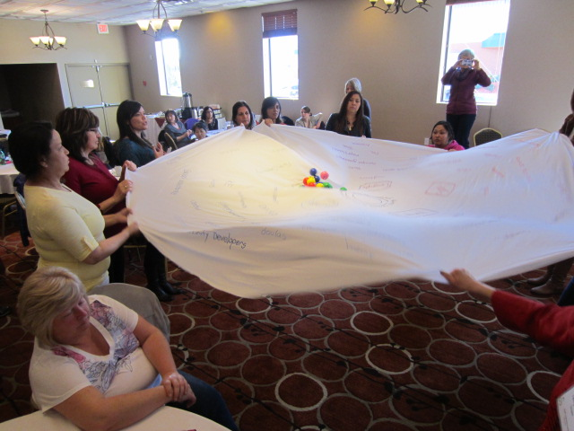

Slide 9
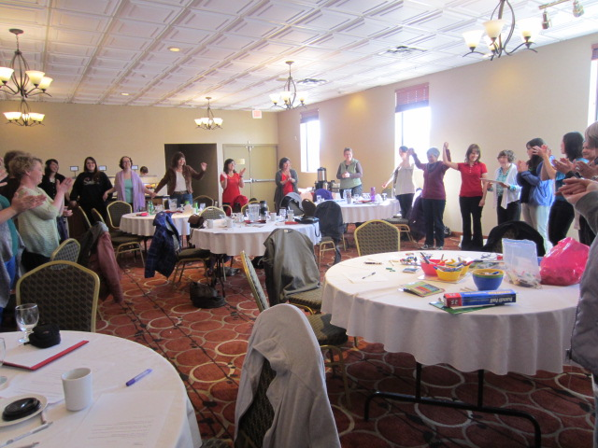

Slide 10
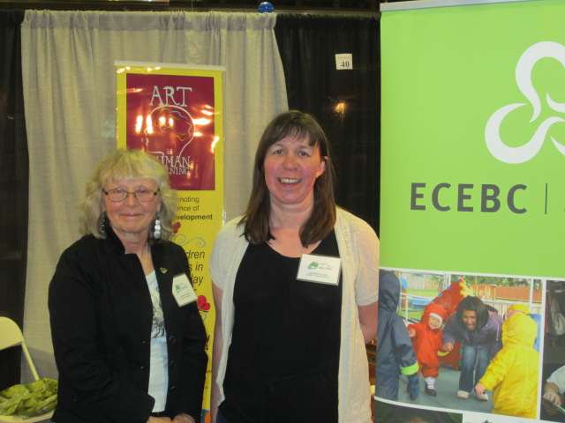
Local Trade Fair Display

Slide 11
Bridging the Gaps
Next steps:
The team is continuing to work toward increasing membership in the Terrace Branch of ECEBC with a membership drive planned for Fall 2014.

